Slide 1
DATA QUALITY AND DATA REPRESENTATION

Slide 2

Data Quality – Data Preparation and Cleaning
Data Quality – Missing Values and Imputation
Data Quality – Cross Validation
Data Quality – Feature Engineering
Data Quality – Dimensionality Reduction
PCA
T-SNE
LSA/LSI
LDA
Word Vectors
Agenda

Slide 3
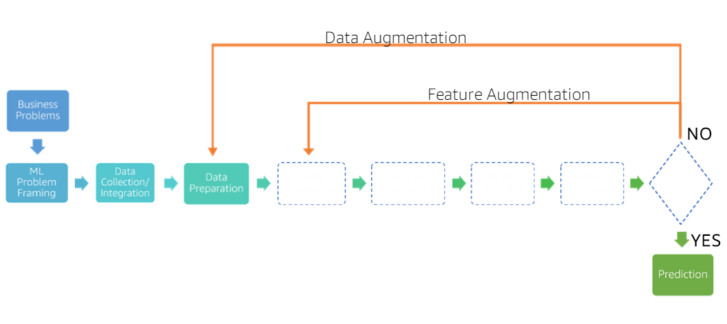
Data Quality – Data Preparation

Slide 4
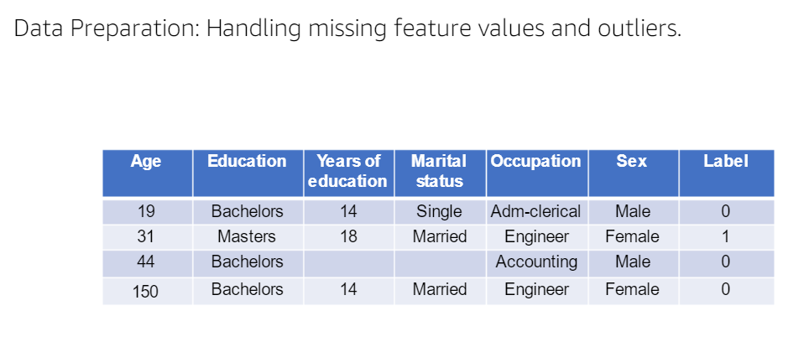
Data Quality – Data Cleaning

Slide 5
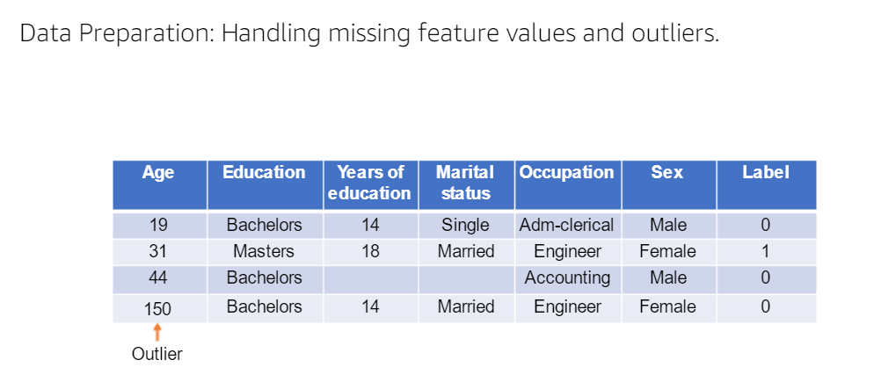
Data Quality – Data Cleaning

Slide 6
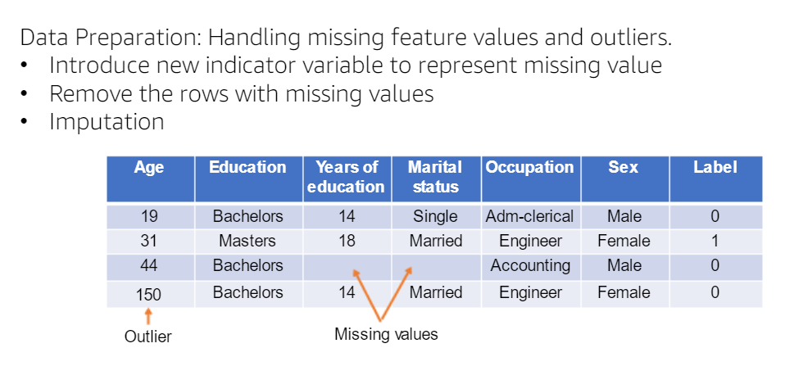
Data Quality – Data Cleaning

Slide 7
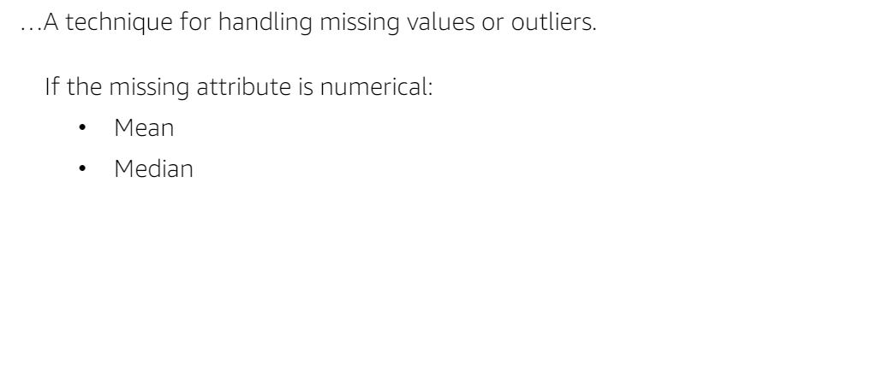
Data Quality – Impute Missing Values

Slide 8
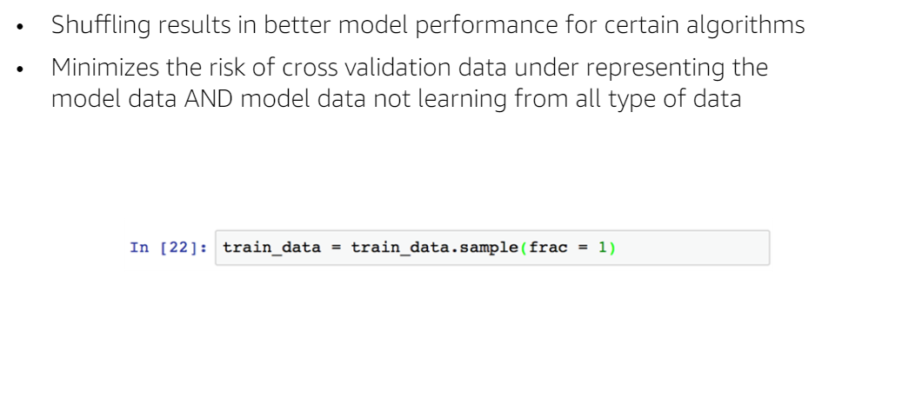
Data Quality – Shuffle Training Data

Slide 9
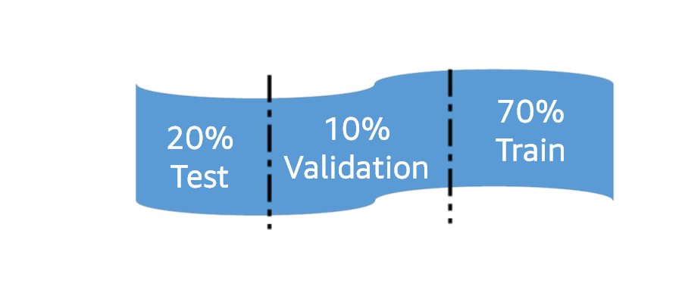
Data Quality – Test-Validation-Train-Split

Slide 10
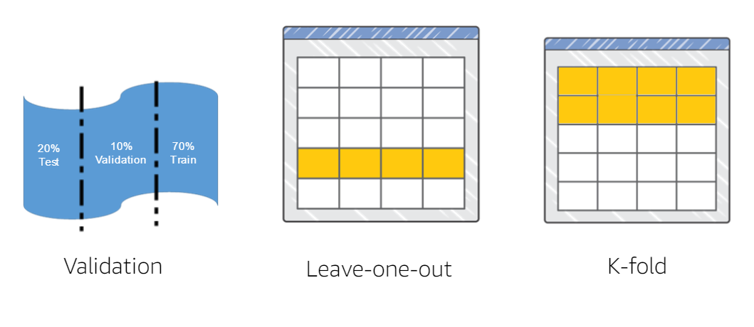
Data Quality – Cross Validation

Slide 11
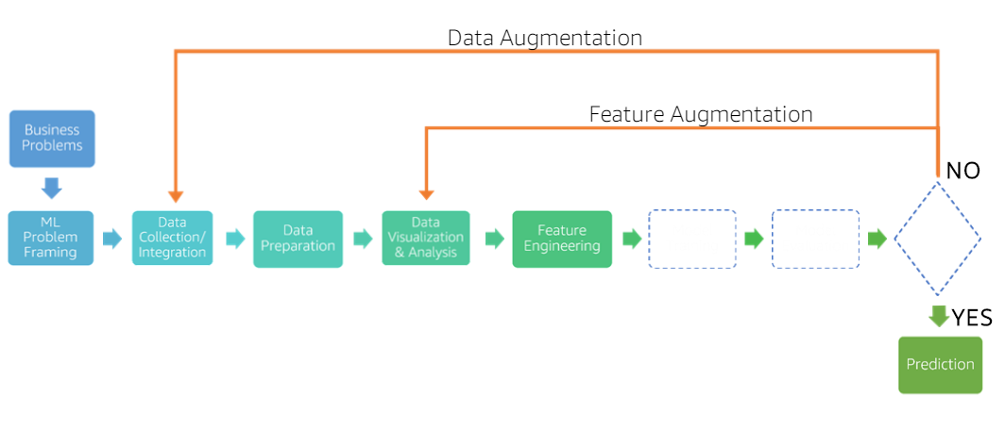
Feature Engineering

Slide 12
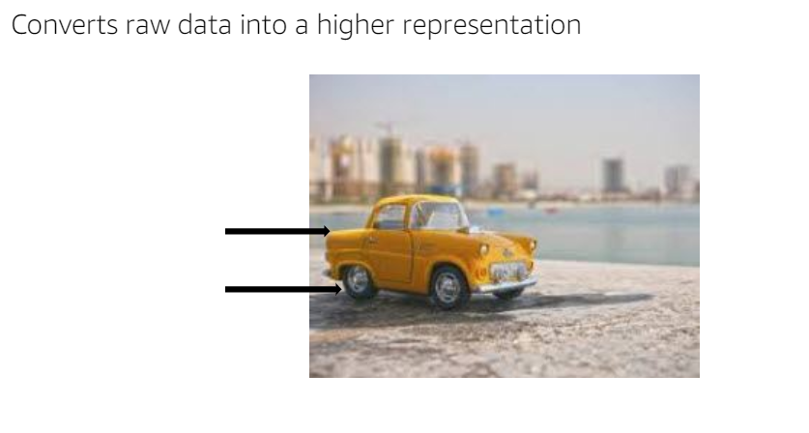
Feature Engineering

Slide 13
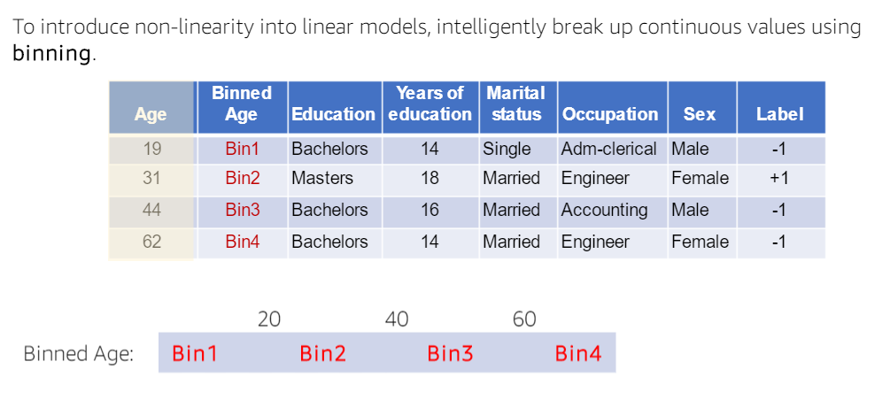
Numeric Value Binning

Slide 14
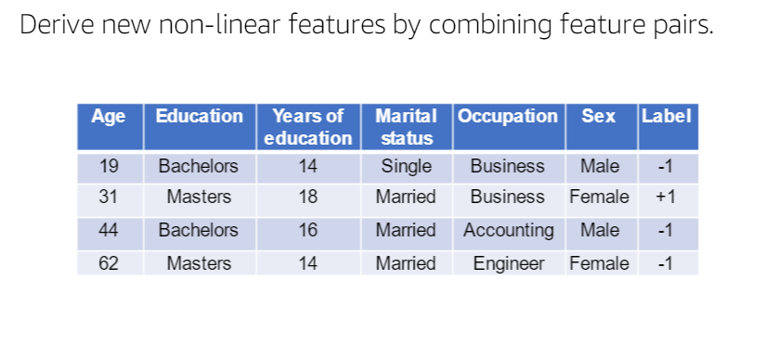
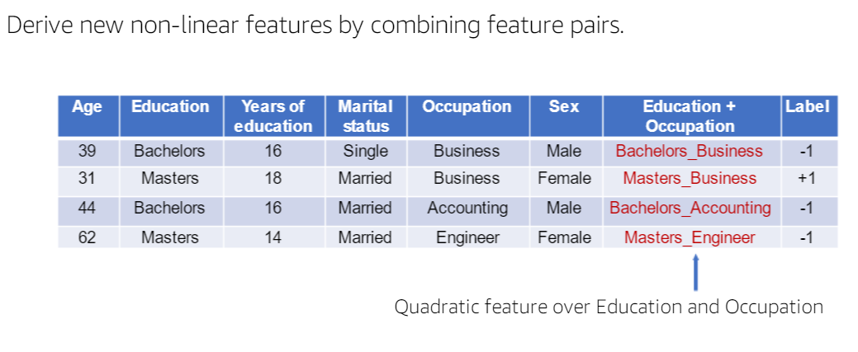
Quadratic Features

Slide 15
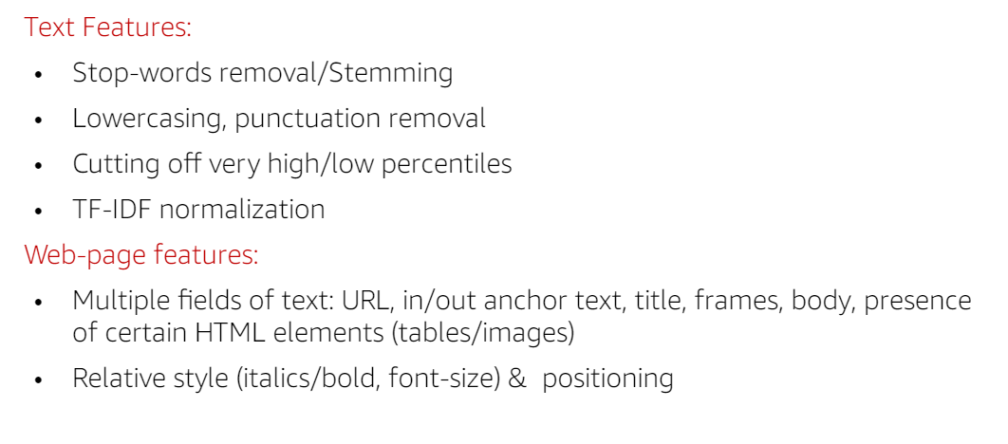
Domain-Specific Transformations

Slide 16

Principal Component Analysis (PCA)

Slide 17
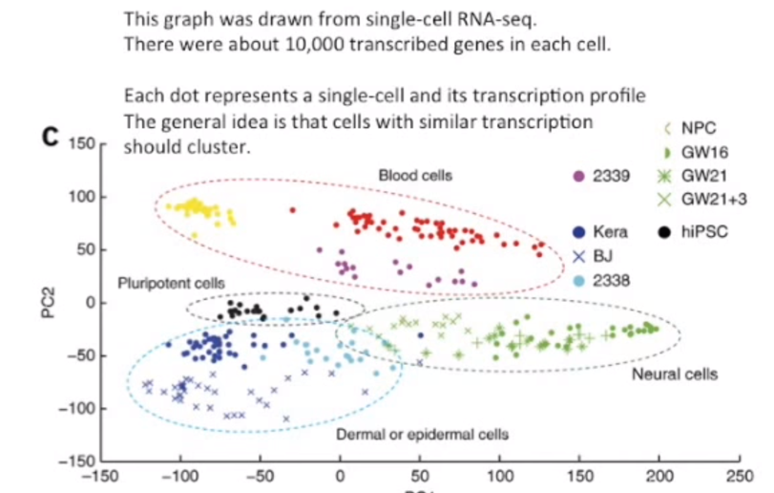
PCA in Action (Cluster of Cell Types)

Slide 18
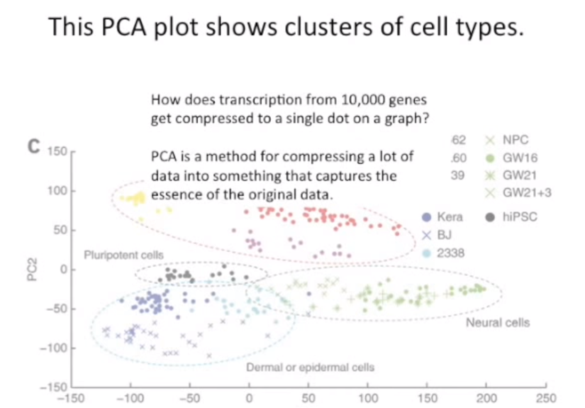

Slide 19
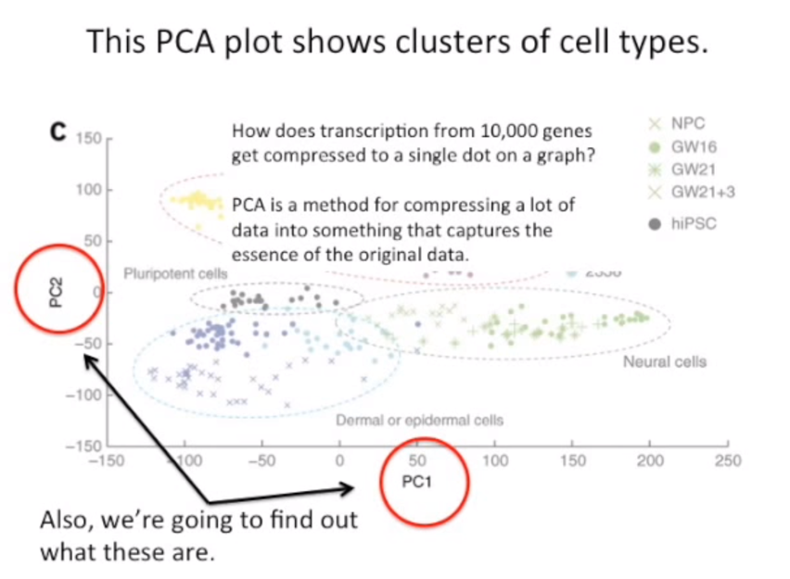

Slide 20
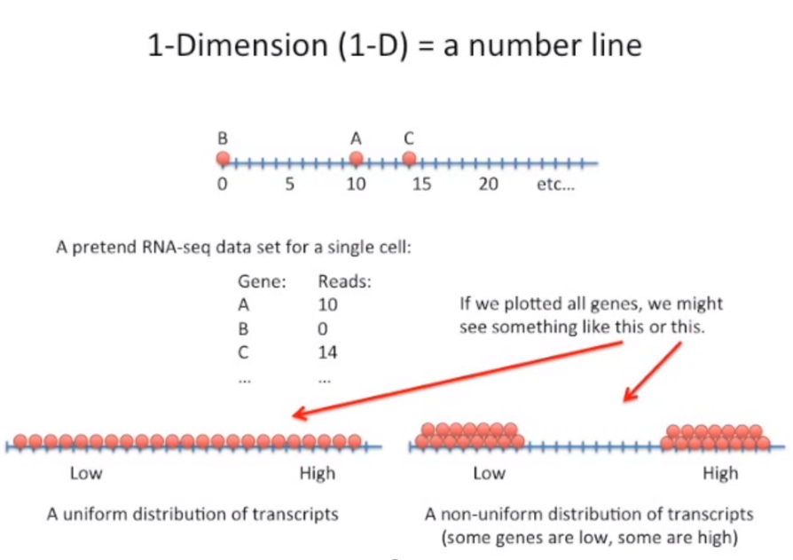

Slide 21
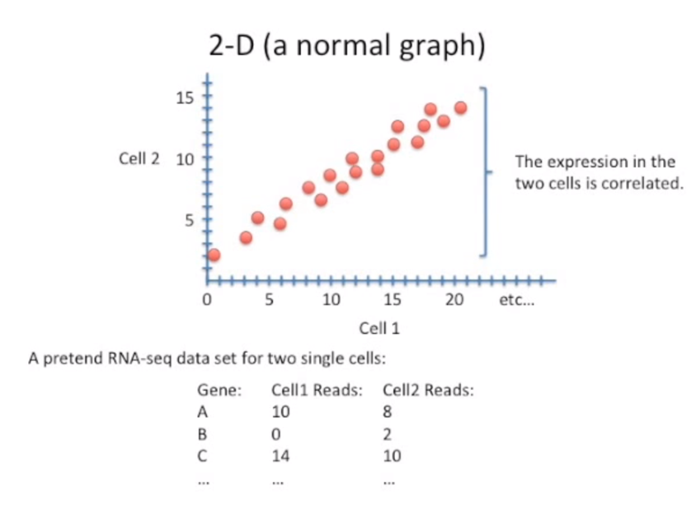

Slide 22
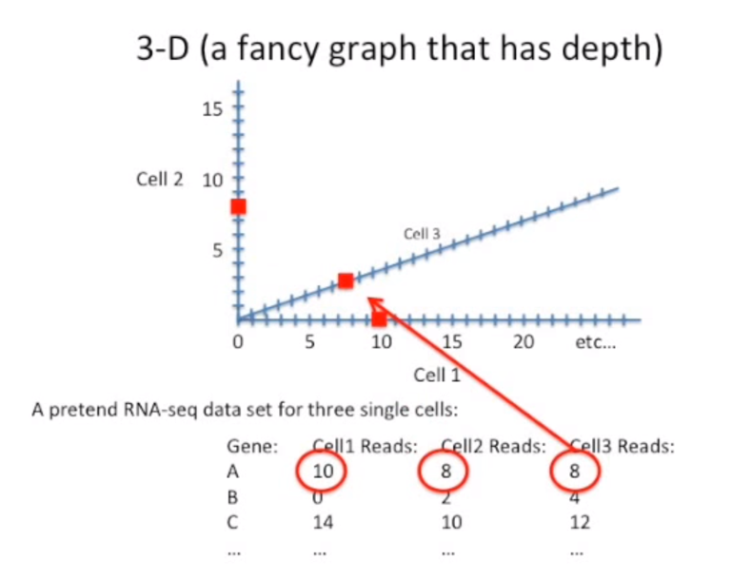
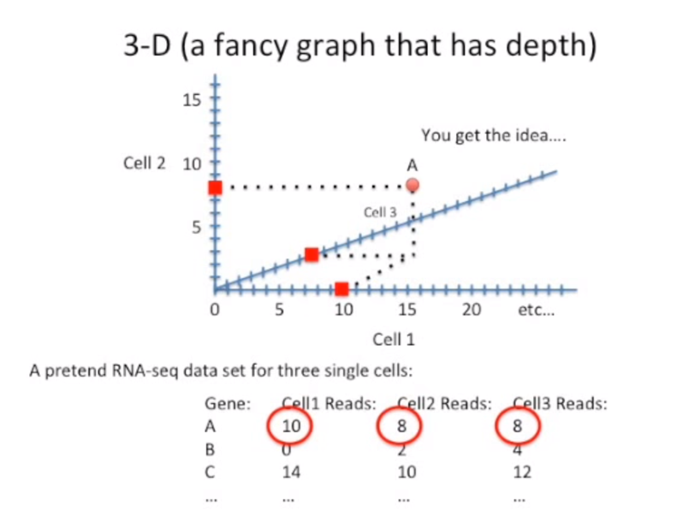

Slide 23
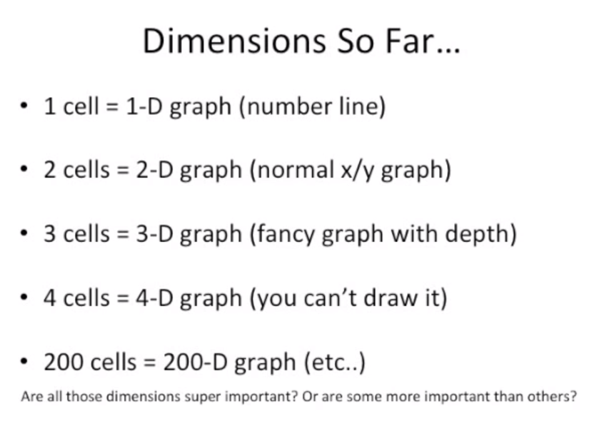

Slide 24
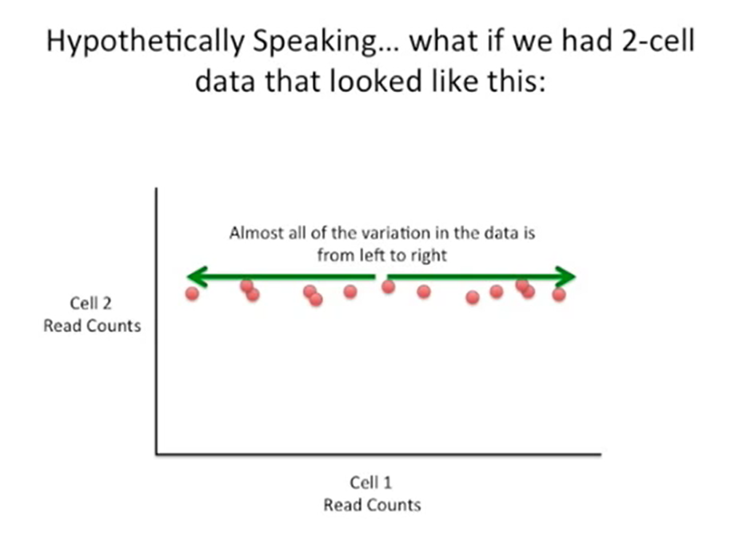
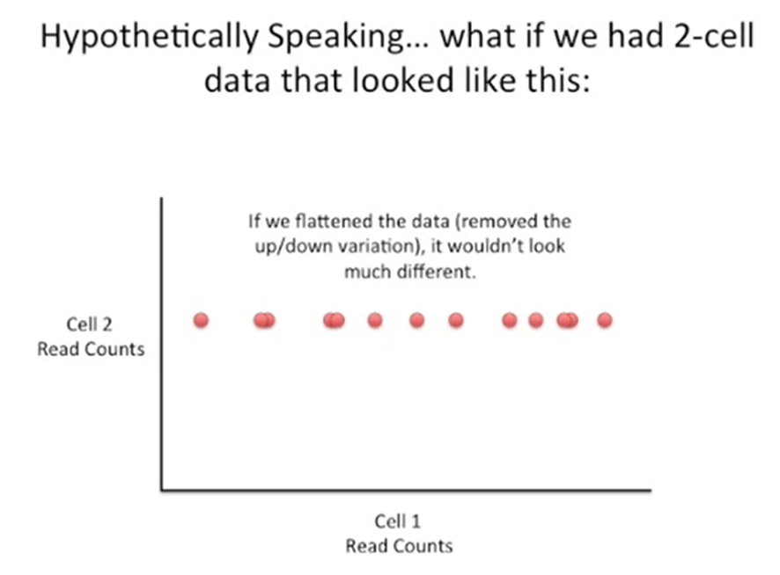

Slide 25
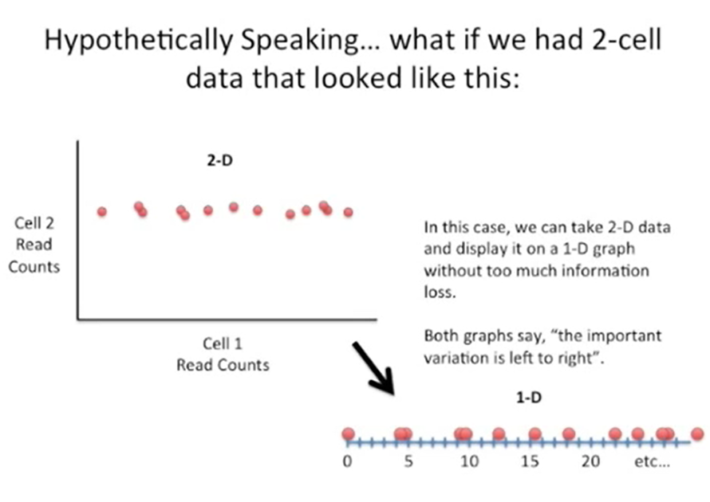

Slide 26
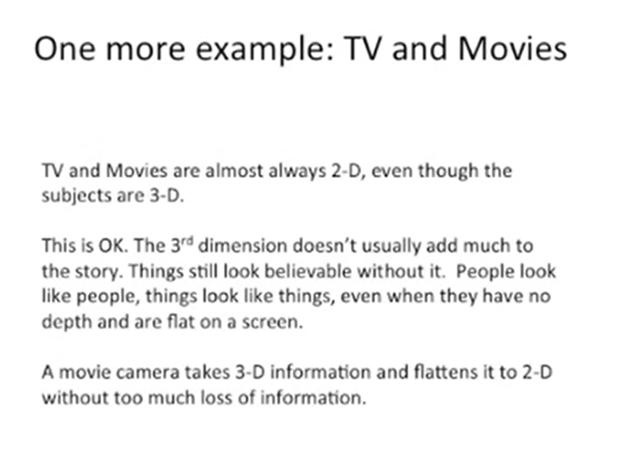

Slide 27
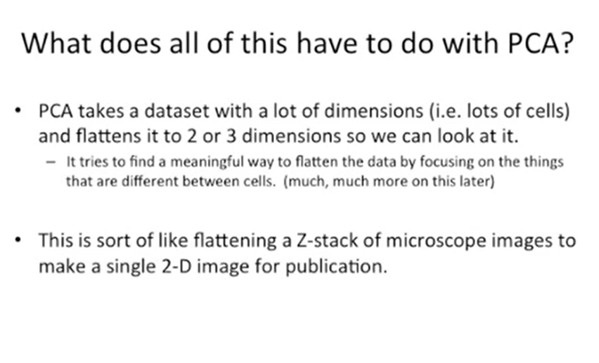

Slide 28
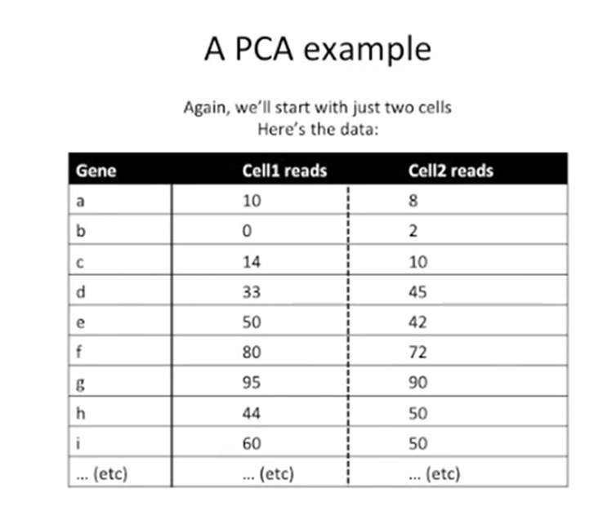
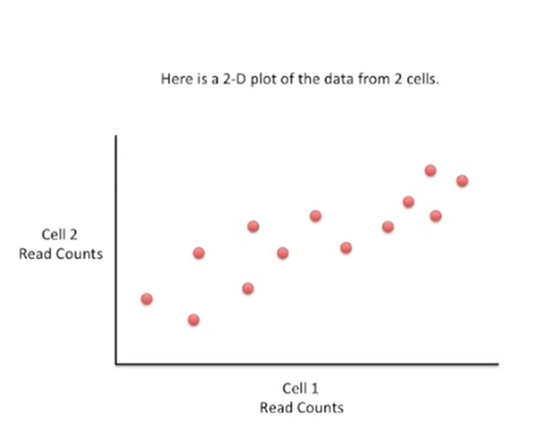

Slide 29
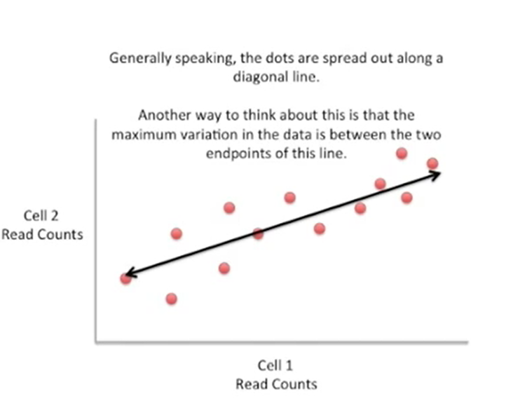
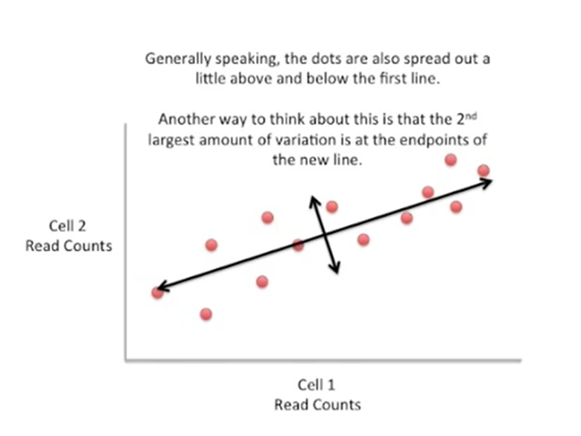

Slide 30
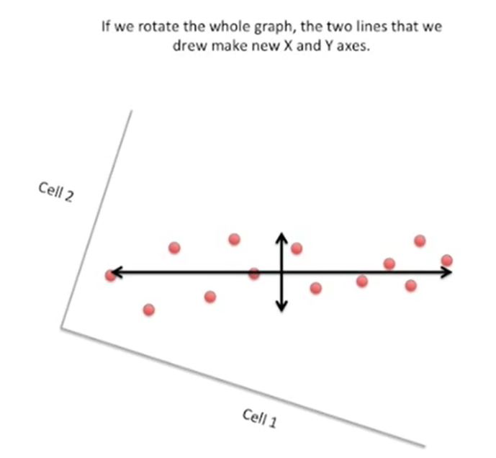
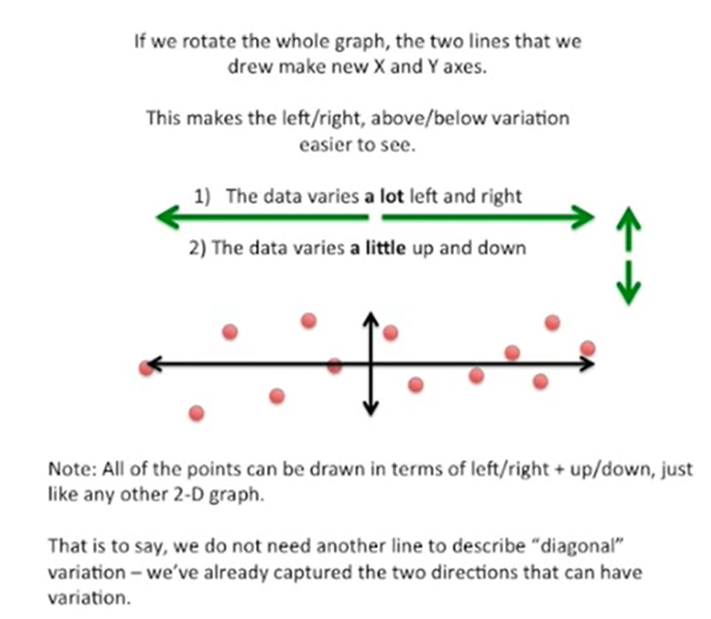
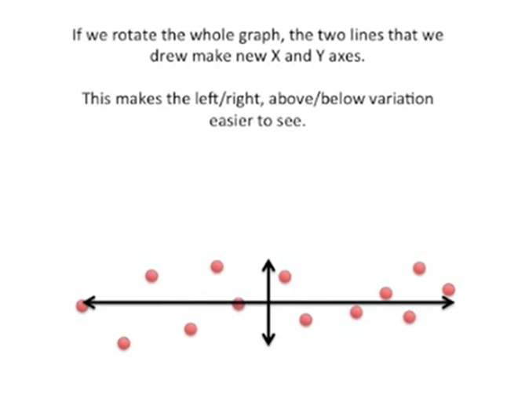

Slide 31
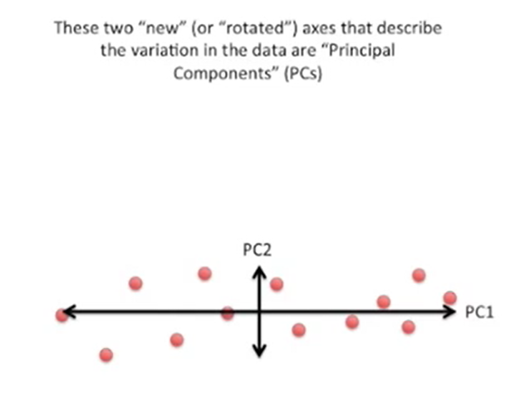
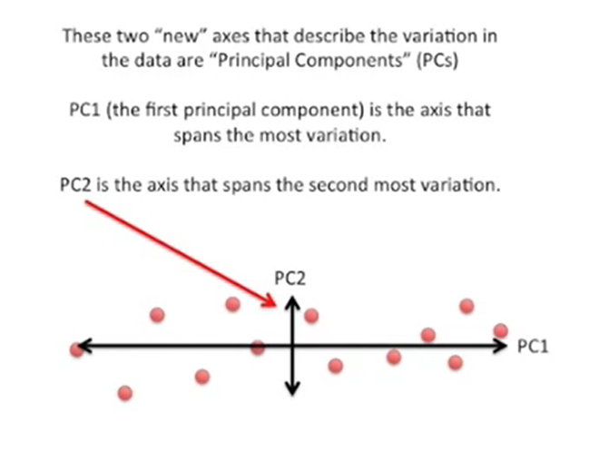

Slide 32
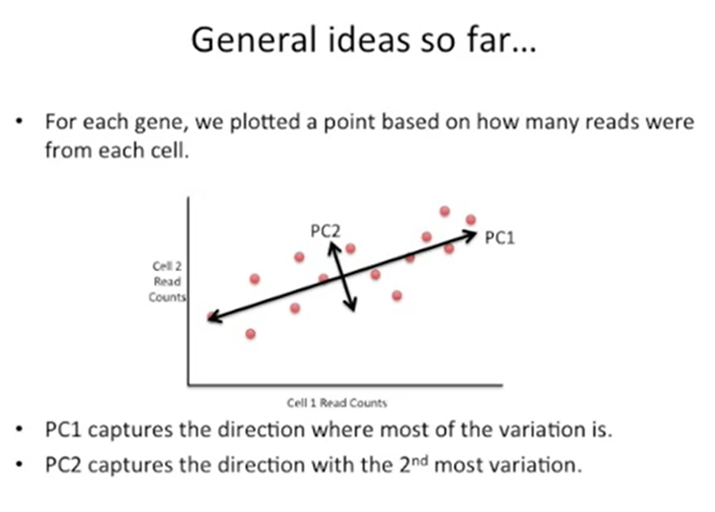

Slide 33
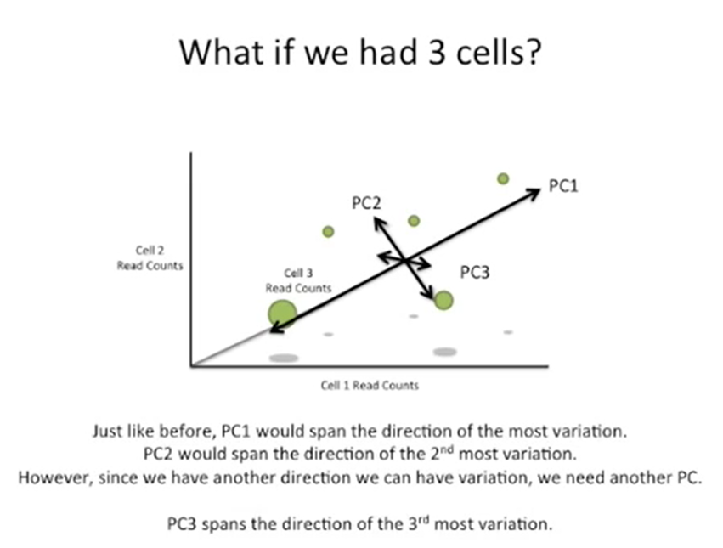

Slide 34
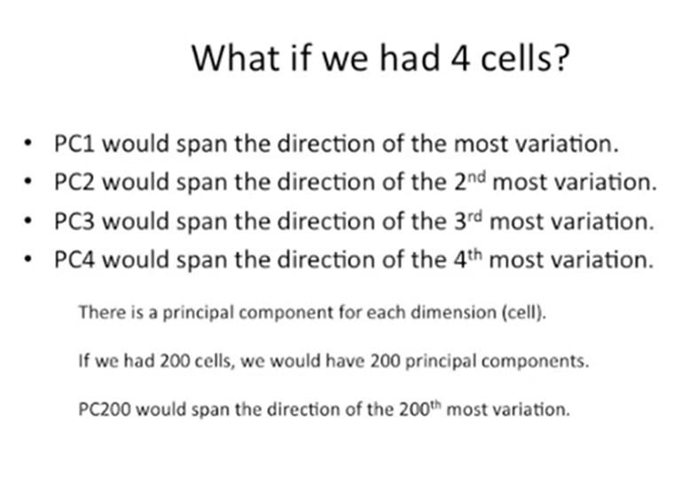

Slide 35
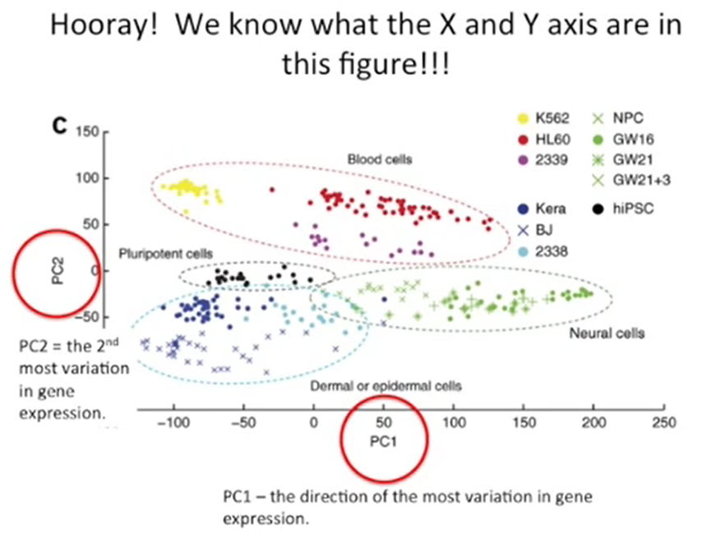
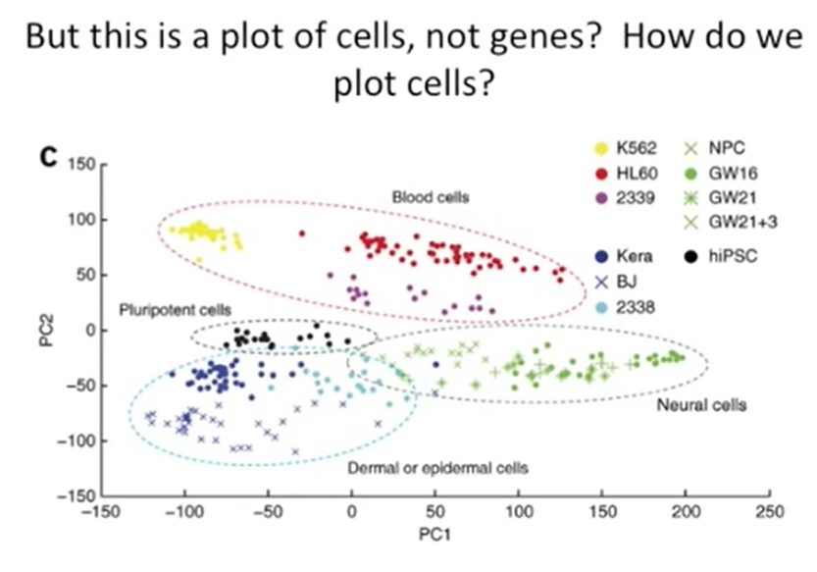

Slide 36
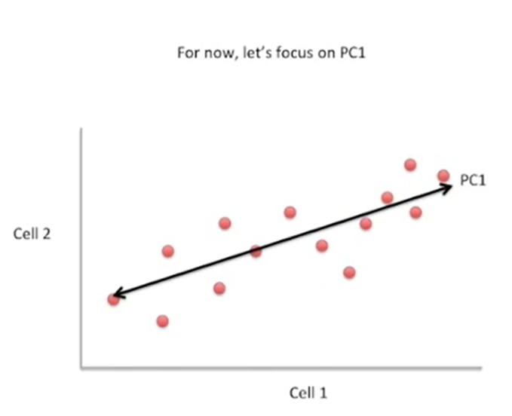
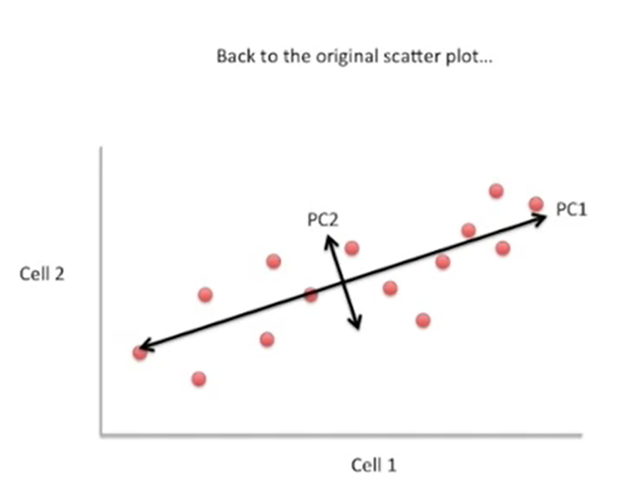
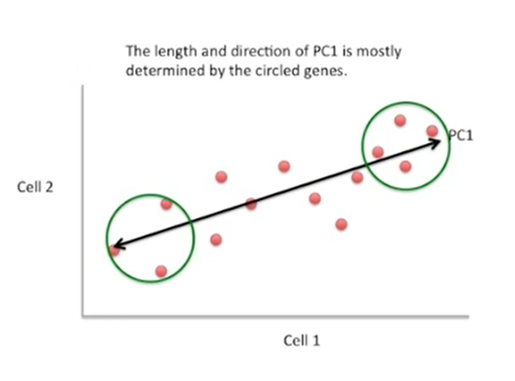

Slide 37
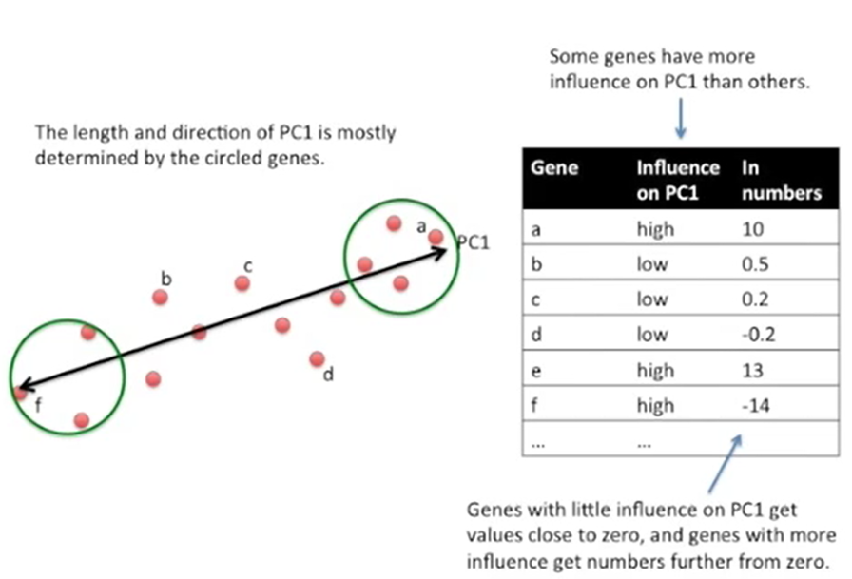

Slide 38
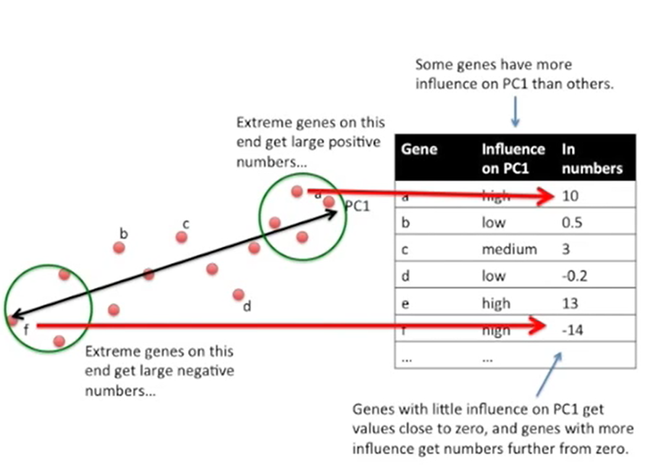

Slide 39
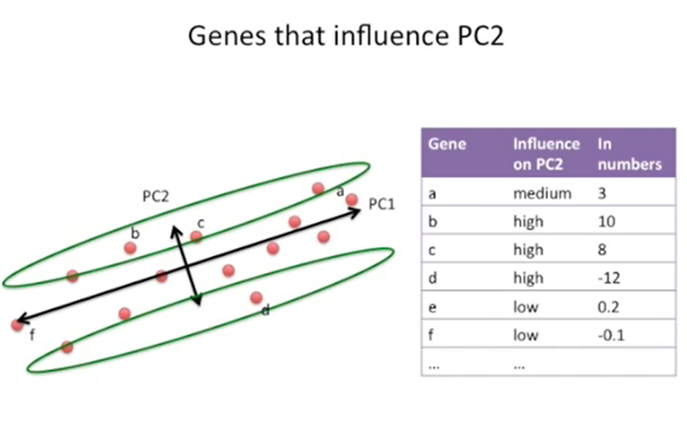

Slide 40
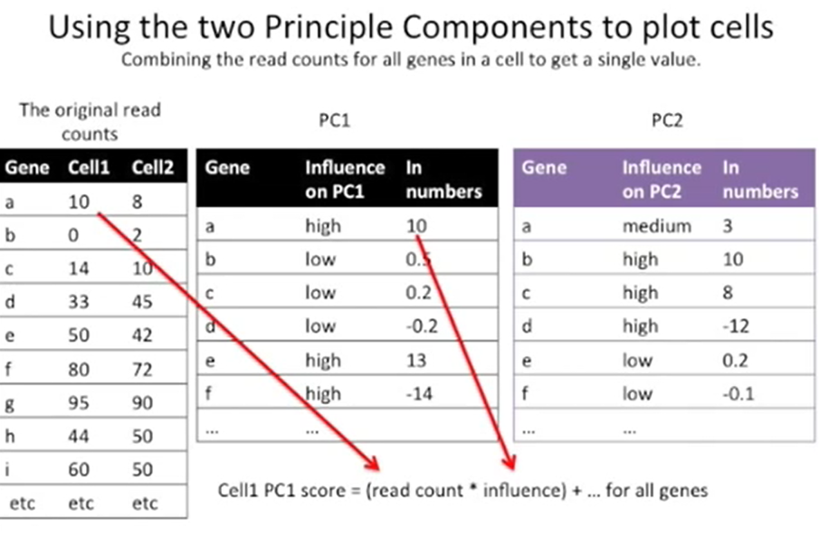
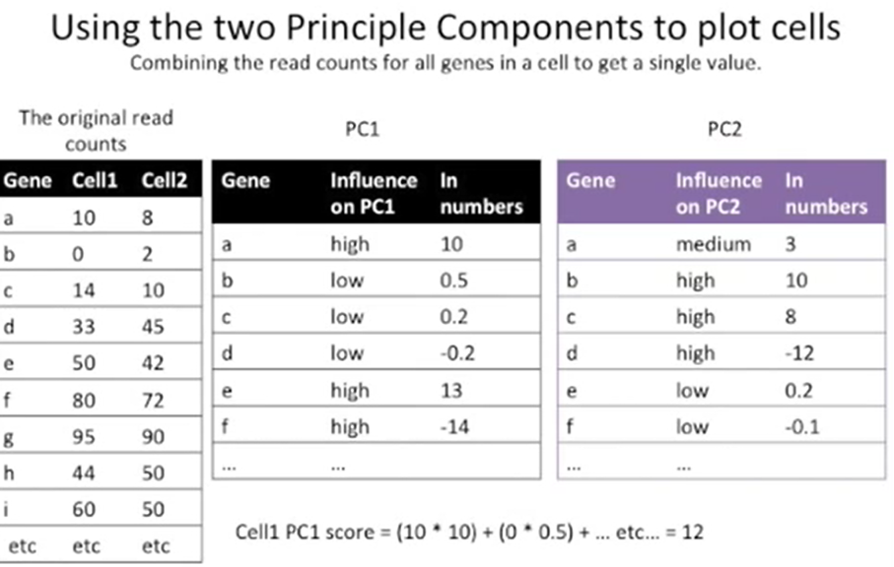

Slide 41
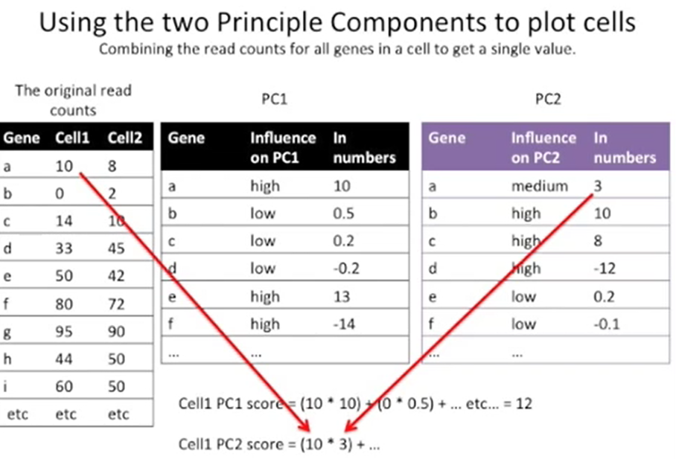


Slide 42


Slide 43


Slide 44


Slide 45



Slide 46


Slide 47


Slide 48
T-SNE

Slide 49



Slide 50


Slide 51


Slide 52



Slide 53


Slide 54


Slide 55


Slide 56


Slide 57


Slide 58



Slide 59


Slide 60



Slide 61


Slide 62



Slide 63



Slide 64


Slide 65



Slide 66




Slide 67



Slide 68



Slide 69


Slide 70



Slide 71


Slide 72


Slide 73


Slide 74


Slide 75


Slide 76


Slide 77




Slide 78




Slide 79


Slide 80



Slide 81


Slide 82



Slide 83


Slide 84


Slide 85


Slide 86


Slide 87


Slide 88



Slide 89


Slide 90


Slide 91


Slide 92


Slide 93
LSA/LSI

Slide 94



Slide 95
LDA

Slide 96



Slide 97
Word Vectors

Slide 98


Slide 100
Thank You

